Slide 1
Architecture Finalization
Design of Multi core cache based on Tiled multi core architecture

Slide 2
Problem and objectives
Problem
Objectives
Private caches replicate the same memory block across cores; without a protocol, copies diverge.
Bus-based coherence serialises every transaction, so it does not scale with core count.
Coherence and data traffic must share one on-chip network without deadlock.
Build a scalable tiled architecture whose tile is identical and replicable.
Keep caches coherent with a MESI directory-based protocol.
Replace the shared bus with a packet-switched Network-on-Chip.
Distribute the L2 into banks with a fixed address-to-home-bank mapping.
Verify the RTL and validate it on an FPGA.
Cache-coherent tiled multi-core SoC | Architecture finalization
2

Slide 3
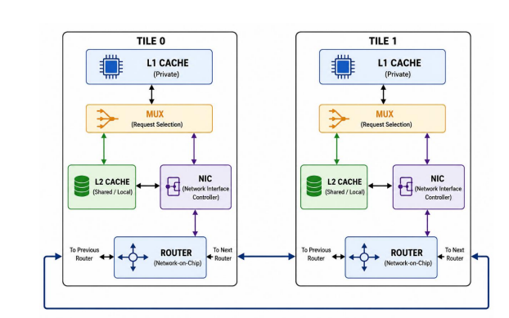
Existing architecture: two-tile bidirectional ring
Verified in RTL simulation and on the Zynq-7000 FPGA
Key facts
Private L1 per tile, banked shared L2 with directory
MESI directory protocol
32-bit flits, wormhole switching
Deterministic routing, bidirectional ring
Address decode: 8-bit, bank field Addr[5:4]
Cache-coherent tiled multi-core SoC | Architecture finalization
3

Slide 4
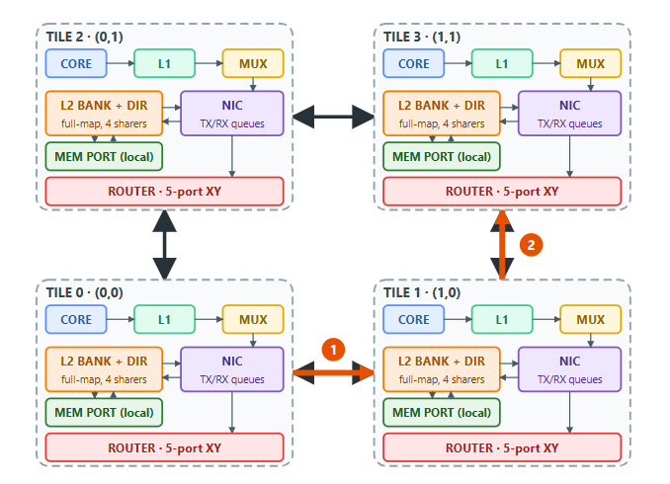
Proposed architecture: 2D mesh [HLD]
Confirmed topology: 2D mesh with point-to-point links; every tile is identical and the mesh is N x N scalable (RTL parameterised, bounded N <= 16 by the directory)
Key features
One 5-port router module (LOCAL, N, S, E, W) instantiated at every tile; edge / corner ports are tied off and pruned by synthesis
Deterministic XY routing, wormhole switching
Credit-based flow control
4 virtual-channel classes: REQ, FWD, RESP, INV
Home tile taken from address bits; no lookup table
Same module scales to any N x N: a 2x2 corner has 3 active ports, a 4x4 interior tile uses all 5
2x2 is the committed FPGA emulation target (LUT capacity); 4x4 is the simulation configuration, not an architectural limit
Write policy: L1 and L2 both write-back + write-allocate (L1 store miss fetches via GETM, then writes; L2 fills install the line)
5

Slide 5
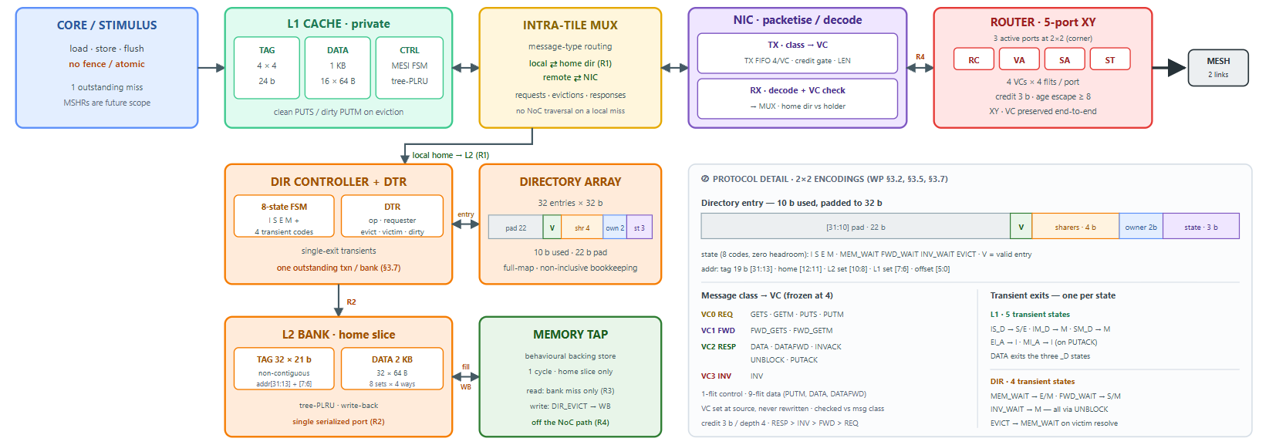
[LLD]Low-Level Design — Per-Tile Coherence Datapath (2×2 Implementation)
NOTE on "MESH / 2 links": the figure shows the 2x2 implementation, where every tile is a corner tile, so only 3 ports are active (LOCAL + 2 mesh links) and the other 2 are tied off. The router module itself is always the same 5-port block, so the mesh scales to any N x N (RTL parameterised; bounded at N <= 16 by the full-map directory). 2x2 is the committed FPGA target because of LUT capacity, not an architectural limit.

Slide 6
Existing vs. Proposed Architecture
Architectural Metric | Existing — 2‑Tile Ring | Proposed — 2D Mesh
Network topology | Two‑tile bidirectional ring | 2D mesh with point‑to‑point links
Scalability | Fixed two‑tile ring; ring links serialize traffic as tiles increase | Identical replicable tiles; same 5-port router module at every position; N x N scalable, bounded N <= 16 by the directory; 2x2 FPGA emulation + 4x4 simulation
Router & routing | Ring router with previous/next ports; deterministic bidirectional ring routing | 5-port router (LOCAL, N, S, E, W) - one module reused at every tile; edge / corner ports tied off; deterministic XY routing
Switching, flow control & VCs | 32‑bit flits; wormhole switching | 32‑bit flits; wormhole switching; credit‑based flow control; 4 VC classes: REQ, FWD, RESP, INV
Cache hierarchy & controller | Private L1 per tile; banked shared L2; unified L1/L2 FSM | Private L1; per-tile L2 bank; split L1/L2 FSMs; 4 sets x 4 ways, 64 B line; WRITE-BACK + write-allocate at BOTH L1 and L2
Coherence & directory | MESI directory‑based; directory lookup tied to shared L2 banks | MESI directory-based; distributed directory per L2 bank; 4-bit sharer vector; write-through is excluded: it would erase the L1 M state and the silent E->M upgrade. DIR_M tracks the L1 owner being newer than the bank - it survives L2 write-through, not L1 write-through. Eviction: L1 dirty -> PUTM, L1 clean -> PUTS; L2 dirty eviction -> write-back to mem_tap.
Network interface | NIC between L2 and ring router | NIC with packetize/decode, TX/RX queues, VC grant/check
Latency / scaling | Ring latency grows with ring span; higher latency when scaling | Bounded XY hop count; avoids shared‑ring serialization and scales better with mesh size

Slide 7

Thank You

